Slide 1
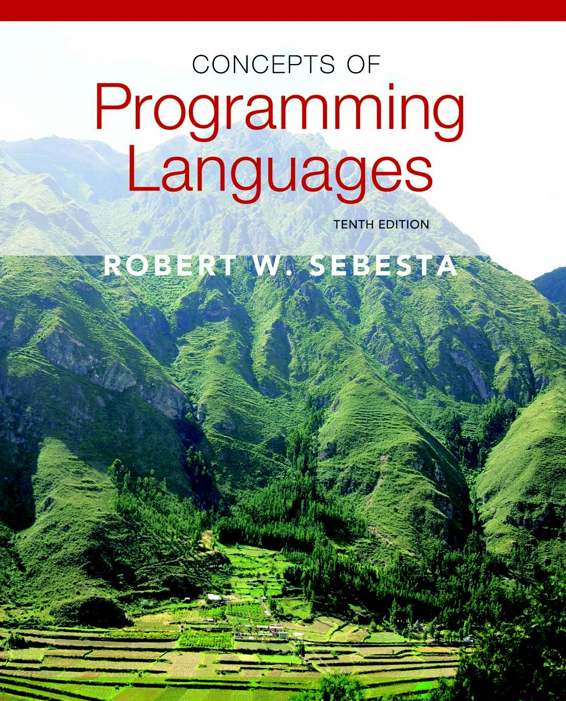
Copyright © 2012 Addison-Wesley. All rights reserved.

Slide 2
Lecture 1: Overview of Programming Languages
CS408
(Covering Chapter 1 & Chapter 2)

Slide 3
Programming Domains
Scientific applications
Large numbers of floating point computations; use of arrays
Fortran, C++, C, …
Business applications
Produce reports, use decimal numbers and characters
COBOL, SQL, PL/B, Java, C#(.NET) …
Artificial intelligence
Symbols rather than numbers manipulated; use of linked lists
LISP, Prolog, C++, …
Systems programming
Need efficiency because of continuous use
C, C++, PL/I, GO (google), …
Web Software
Collection of languages: markup (e.g., XHTML), scripting (e.g., PHP), general-purpose (e.g., Java)
Notes:
3

Slide 4
Language Categories
Imperative
Central features are variables, assignment statements, and iteration
Include languages that support object-oriented programming
Include scripting languages
Include the visual languages
Examples: C, Java, Perl, JavaScript, Visual BASIC .NET, C++
Functional
Main means of making computations is by applying functions to given parameters
Examples: LISP, Scheme
Logic
Rule-based (rules are specified in no particular order)
Example: Prolog
Markup/programming hybrid
Markup languages extended to support some programming
Examples: JSTL, XSLT
Notes:
4

Slide 5
Language Evaluation Criteria
Readability: the ease with which programs can be read and understood
Syntax, data types, …
Writability: the ease with which a language can be used to create programs
Support for abstraction, expressivity (operators, predefined functions, …)
Reliability: conformance to specifications (i.e., performs to its specifications)
Type checking, exception handling, …
Cost: the ultimate total cost
Training programmers, compiling/executing programs, implementation, …
Portability, generality, …
Notes:
5

Slide 6
Language families: contrast
//C:
int gcd (int a, int b) {
while (a != b) {
if (a > b) a = a – b;
else b = b – a;
}
return a;
}
#Scheme:
(define gcd
(lambda (a b)
(cond ((= a b) a)
((> a b) (gcd (- a b) b))
(else (gcd a (- b a))))))
%Prolog
gcd(A,B,G) :- A = B, G=A.
gcd(A,B,G) :- A>B, C is A-B, gcd(C,B,G).
gcd(A,B,G) :- B>A, C is B-A, gcd(C,A,G).

Slide 7
Language Design Trade-Offs
Reliability vs. cost of execution
Example: Java demands all references to array elements be checked for proper indexing, which leads to increased execution costs
Readability vs. writability
Example: APL provides many powerful operators (and a large number of new symbols), allowing complex computations to be written in a compact program but at the cost of poor readability (attachment: APL keyboard image)
Writability (flexibility) vs. reliability
Example: C++ pointers are powerful and very flexible but are unreliable
Notes:
7

Slide 8
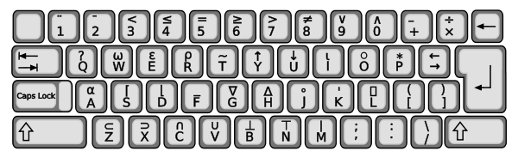
APL keyboard

Slide 9
Influences on Language Design
Computer Architecture
von Neumann architecture
Stored program concepts
Variables model memory cells
Parallel computers and multicores
Concurrency, multithreading, …
Programming design methodologies
Object-oriented programming
Data-oriented vs. procedure oriented

Slide 10
Implementation Methods
Compilation
Translate source code to object/machine code
Main modules
Syntax analysis, semantics analysis, code generation
Executable user code and system code are linked together and loaded to system before execution
Linking and loading process
Pure interpretation
A software, called interpreter, acts as a software simulation of a machine
Provides a virtual machine for the language
Hybrid implementation system
Translate into intermediate code that allows easy interpretation

Slide 11
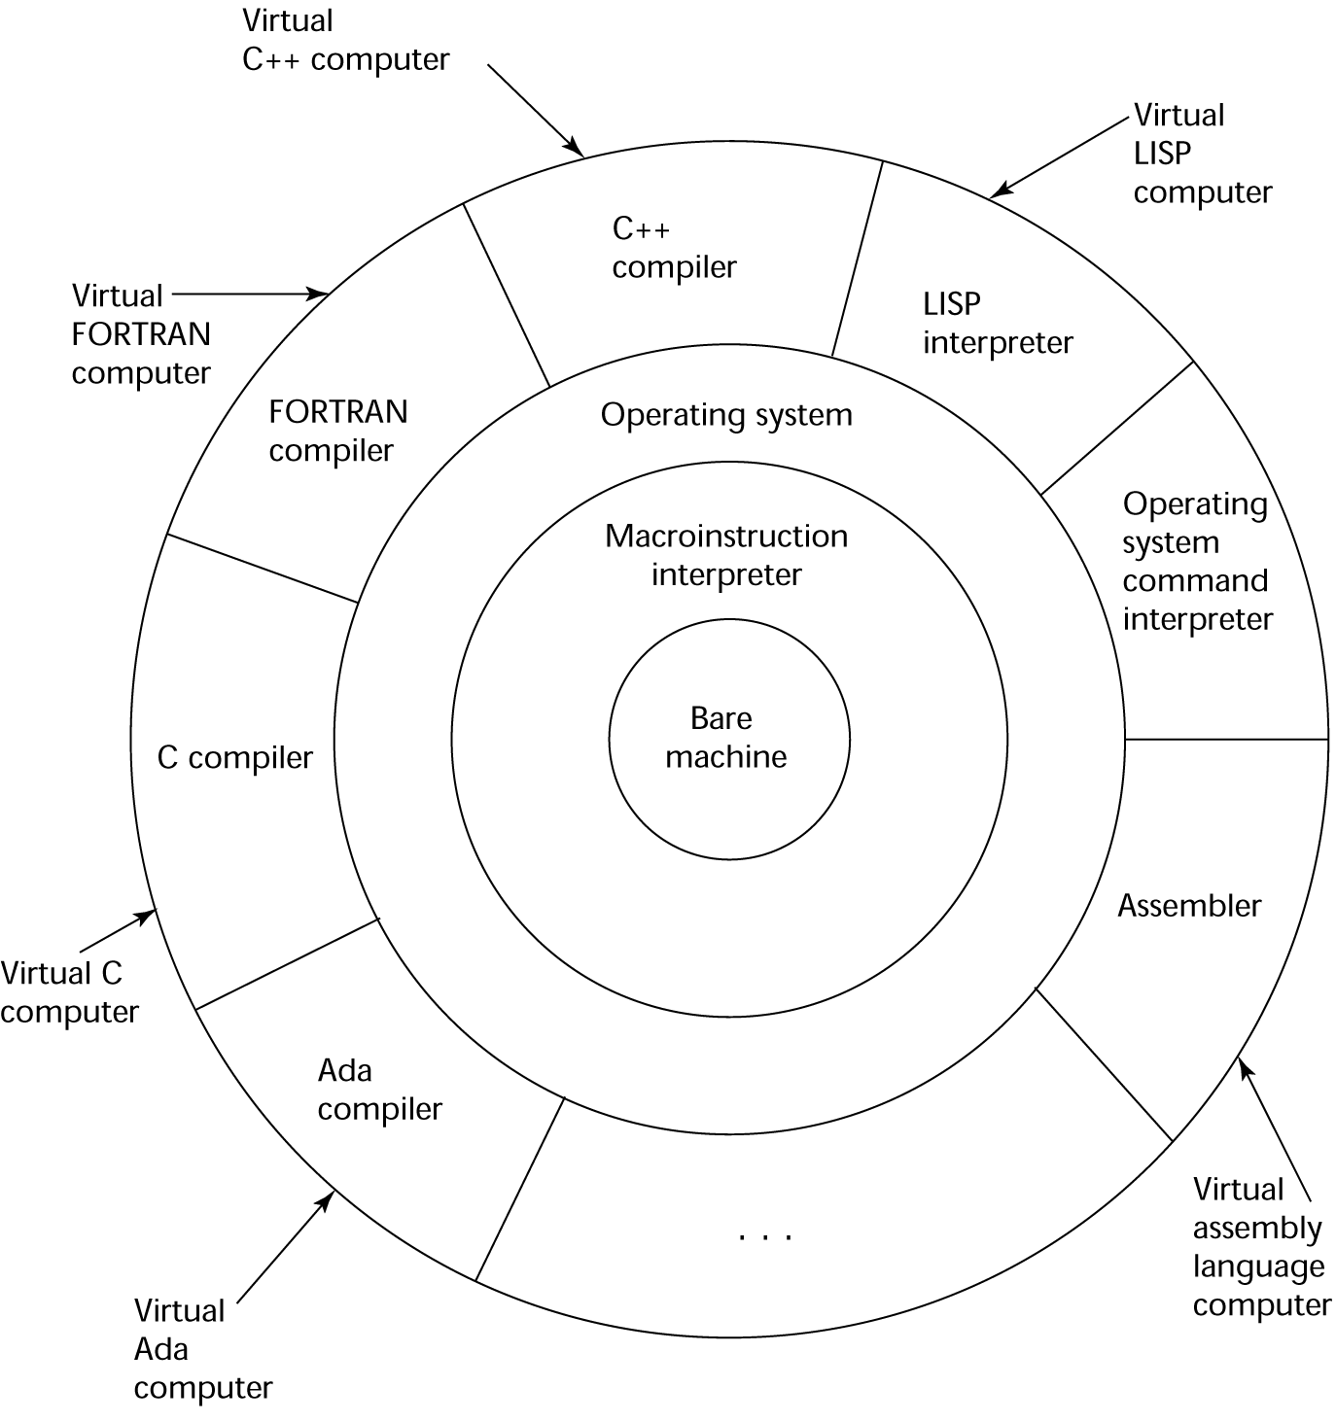
Layered View of Computer
The operating system and language implementation are layered over
machine interface of a computer

Slide 13
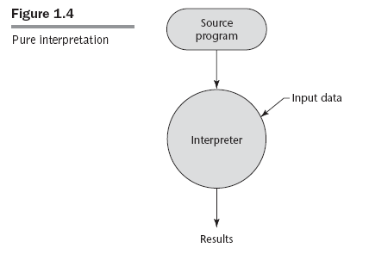

Slide 14
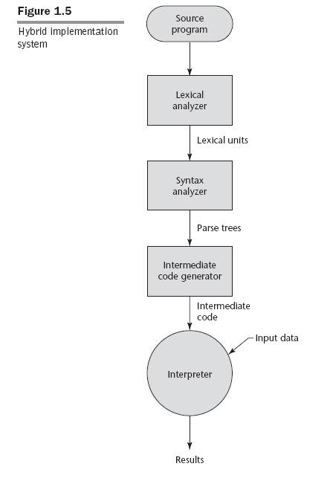

Slide 15
Just-in-Time Implementation Systems
Initially translate programs to an intermediate language
Then compile the intermediate language of the subprograms into machine code when they are called
Machine code version is kept for subsequent calls
JIT systems are widely used for Java programs
.NET languages are implemented with a JIT system
In essence, JIT systems are delayed compilers

Slide 16
Programming Environment
A collection of tools used in the development of software
Tools
file system, text editor, compiler/linker, …
Could also be a large collection of integrated tools
Examples
Unix environment
Borland Jbuilder (for Java development)
NetBeans (for Java applications but also support JavaScript, Ruby, and PHP)
Microsoft Visual Studio .Net

Slide 17
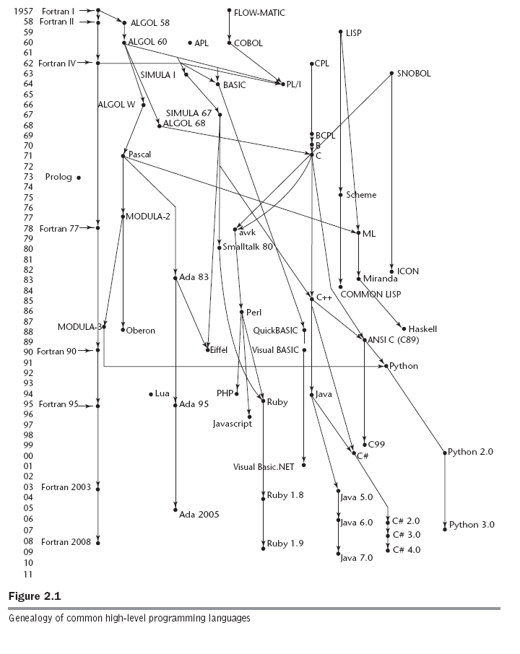
Genealogy of Common Languages
Updated version: page 35 of text

Slide 18
Why “high-level” programming languages?
What was wrong with using machine code?
Poor readability
Poor modifiability
Expression coding was tedious
Machine deficiencies--no indexing or floating point
Example; x86 instruction set machine code for GCD program
55 89 e5 53 83 ec 04 89 e4 f0 e8 31 00 00 00 90 c3 e8 2a 00
00 00 39 c3 74 10 8d b6 00 00 00 00 39 c3 7e 13 29 c3 39 c3
75 f6 89 1c 24 e8 6e 00 00 00 8b 5d fc c9 c3 29 d8 eb eb 90

Slide 19
Machine code, assembly, high-level programs
GCD program in x86 assembly language
The first few lines of the assembly code …
pushl %ebp
movl %esp, %ebp
pushl %ebx
subl $4, %esp
andl $-16, %esp
…
Can you write a GCD program in Java/C++/Python?

Slide 20
Fortran
Fortran 0: 1954 - not implemented
Fortran I:1957
Designed for the new IBM 704, which had index registers and floating point hardware
- This led to the idea of compiled programming languages (earlier languages were interpreted.)
Features
Names could have up to six characters
Post-test counting loop (DO)
Formatted I/O
User-defined subprograms
Three-way selection statement (arithmetic IF)
No data typing statements
Programs larger than 400 lines rarely compiled correctly, mainly due to poor reliability of 704
Fortran 0: 1954 - not implemented
Fortran I:1957
Designed for the new IBM 704, which had index registers and floating point hardware
- This led to the idea of compiled programming languages (earlier languages were interpreted.)
Features
Names could have up to six characters
Post-test counting loop (DO)
Formatted I/O
User-defined subprograms
Three-way selection statement (arithmetic IF)
No data typing statements
Programs larger than 400 lines rarely compiled correctly, mainly due to poor reliability of 704

Slide 21
Fortran
Fortran II: Distributed in 1958
Independent compilation, Fixed the bugs
Fortran IV: Evolved during 1960-62
Explicit type declarations, Logical selection statement
Subprogram names could be parameters
ANSI standard in 1966
Fortran 77: Became the new standard in 1978
Character string handling
Logical loop control statement, IF-THEN-ELSE statement
Fortran 90: Significant changes from Fortran 77
Modules, Dynamic arrays, Pointers, Recursion
CASE statement, Parameter type checking
Fortran 95 & Fortran 2003 -- ditto

Slide 22
Fortran Evaluation
Highly optimizing compilers (all versions before 90)
Types and storage of all variables are fixed before run time
Dramatically changed forever the way computers are used
Characterized as the lingua franca of the computing world

Slide 23
Functional Programming: LISP
LISt Processing language
Designed at MIT by McCarthy
AI research needed a language to
Process data in lists (rather than arrays)
Symbolic computation (rather than numeric)
Only two data types: atoms and lists
Syntax is based on lambda calculus

Slide 24
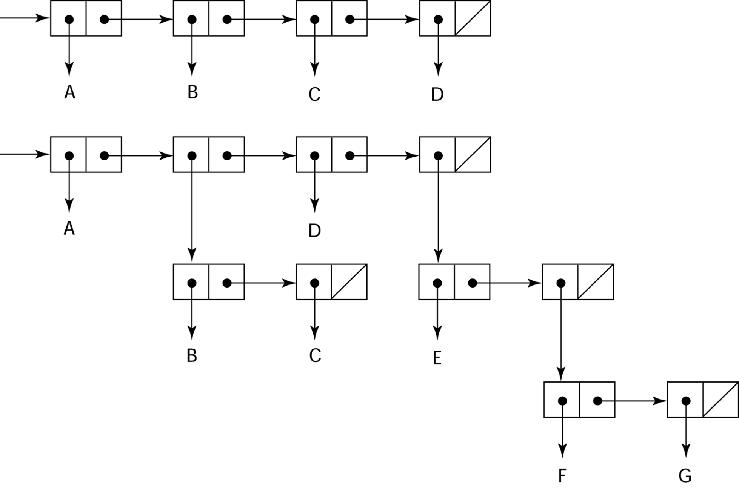
Representation of Two LISP Lists
Representing the lists (A B C D)
and (A (B C) D (E (F G)))

Slide 25
LISP Evaluation
Pioneered functional programming
No need for variables or assignment
Control via recursion and conditional expressions
Still the dominant language for AI
COMMON LISP and Scheme are contemporary dialects of LISP
ML, Miranda, and Haskell are related languages

Slide 26
The First Step Toward Sophistication: ALGOL 60
Environment of development
FORTRAN had (barely) arrived for IBM 70x
Many other languages were being developed, all for specific machines
No portable language; all were machine- dependent
No universal language for communicating algorithms
ALGOL 60 was the result of efforts to design a universal language

Slide 27
Early Design Process
Goals of the language
Close to mathematical notation
Good for describing algorithms
Must be translatable to machine code
ALGOL 58
Concept of type was formalized, names could be any length, arrays could have any number of subscripts
Parameters were separated by mode (in & out)
Compound statements (begin ... end)
if had an else-if clause
No I/O - “would make it machine dependent”

Slide 28
ALGOL 60 Overview
Modified ALGOL 58 with new features
Block structure (local scope)
Two parameter passing methods (in, out)
Subprogram recursion
Stack-dynamic arrays
Still no I/O and no string handling

Slide 29
ALGOL 60 Evaluation
Successes
the standard way to publish algorithms for over 20 years
All subsequent imperative languages are based on it
First machine-independent language
First language whose syntax was formally defined (BNF)
Failure
Never widely used, especially in U.S.
Reasons
Lack of I/O & the character set: programs non-portable
Too flexible--hard to implement
Competition with Fortran
Lack of support from IBM

Slide 30
Computerizing Business Records: COBOL
Still the most widely used business applications language
Contributions
First macro facility in a high-level language
Hierarchical data structures (records)
Nested selection statements
Long names (up to 30 characters), with hyphens
Separate data division

Slide 31
The Beginning of Timesharing: BASIC
Beginner's All-purpose Symbolic Instruction Code (BASIC)
Design Goals:
Easy to learn and use for non-science students
Must be “pleasant and friendly”
User time is more important than computer time
Current popular dialect: Visual BASIC
First widely used language with time sharing

Slide 32
The Beginning of Data Abstraction: SIMULA 67
Designed primarily for system simulation
Based on ALGOL 60
Primary Contributions
Coroutines - a kind of subprogram
Classes, objects, and inheritance

Slide 33
ALGOL 68
Continued development of ALGOL 60
Source of several new ideas
But the language itself never achieved widespread use
Contributions
User-defined data structures
Reference types
Dynamic arrays (called flex arrays)
Comments
Less usage than ALGOL 60
Had strong influence on subsequent languages, especially Pascal, C, and Ada

Slide 34
Pascal - 1971
Developed by Wirth (a former member of the ALGOL 68 committee)
Designed for teaching structured programming
Small, simple, nothing really new
Largest impact was on teaching programming
From mid-1970s until the late 1990s, it was the most widely used language for teaching programming

Slide 35
C - 1972
Designed for systems programming (at Bell Labs by Dennis Richie)
Evolved primarily from BCLP, B, but also ALGOL 68
Powerful set of operators, but poor type checking
Initially spread through UNIX
Many areas of application

Slide 36
Programming Based on Logic: Prolog
Based on formal logic
Non-procedural
Can be summarized as being an intelligent database system that uses an inferencing process to infer the truth of given queries
Highly inefficient, small application areas
Based on formal logic
Non-procedural
Can be summarized as being an intelligent database system that uses an inferencing process to infer the truth of given queries
Highly inefficient, small application areas

Slide 37
History’s Largest Design Effort: Ada
Huge design effort, involving hundreds of people, lot of money, and ~ 8 years
Contributions
Packages - support for data abstraction
Exception handling - elaborate
Generic program units
Concurrency - through the tasking model
Comments
Competitive design
Included all that was then known about software engineering and language design
Ada 95
Support for OOP
Not popular because of the popularity of C++

Slide 38
Object-Oriented Programming: Smalltalk
First full implementation of an object-oriented language (data abstraction, inheritance, and dynamic binding)
Pioneered the graphical user interface design
Promoted OOP

Slide 39
Combining Imperative and Object-Oriented Programming: C++
Developed at Bell Labs by Stroustrup in 1980
Evolved from C and SIMULA 67
Facilities for object-oriented programming, taken partially from SIMULA 67
Provides exception handling
A large and complex language, in part because it supports both procedural and OO programming
Rapidly grew in popularity, along with OOP
ANSI standard approved in November 1997
Microsoft’s version (released with .NET in 2002): Managed C++
delegates, interfaces, no multiple inheritance

Slide 40
Related OOP Languages
Eiffel (designed by Bertrand Meyer - 1992)
Not directly derived from any other language
Smaller and simpler than C++, but still has most of the power
Lacked popularity of C++ because many C++ enthusiasts were already C programmers
Delphi (Borland)
Pascal plus features to support OOP
More elegant and safer than C++

Slide 41
An Imperative-Based Object-Oriented Language: Java
Developed at Sun in the early 1990s
C and C++ were not satisfactory for embedded electronic devices
Based on C++
Significantly simplified (does not include struct, union, pointer arithmetic, and half of the assignment coercions of C++)
Supports only OOP
Has references, but not pointers
Includes support for applets and a form of concurrency

Slide 42
Java Evaluation
Eliminated many unsafe features of C++
Supports concurrency
Libraries for applets, GUIs, database access
Portable: Java Virtual Machine concept, JIT compilers
Widely used for Web programming
Use increased faster than any previous language
Most recent version, 5.0, released in 2004

Slide 43
Scripting Languages for the Web
Perl
Variables are statically typed but implicitly declared
Three distinctive namespaces, denoted by the first character of a
variable’s name
Powerful, but somewhat dangerous
Gained widespread use for CGI programming on the Web
Also used for a replacement for UNIX system administration language
JavaScript
Began at Netscape, later joint venture of Netscape and Sun Microsystems
A client-side HTML-embedded scripting language, often used to create dynamic HTML documents
Purely interpreted
Related to Java only through similar syntax
PHP
PHP: Hypertext Preprocessor
A server-side HTML-embedded scripting language, often used for form processing and database access through the Web
Purely interpreted

Slide 44
Scripting Languages for the Web
Python
An OO interpreted scripting language
Used for CGI programming and form processing
Type checked but dynamically typed
Ruby
Began as a replacement for Perl and Python
A pure object-oriented scripting language
- All data are objects
Most operators are implemented as methods, which can be redefined by user code
Purely interpreted

Slide 45
A C-Based Language for the New Millennium: C#
Part of the .NET development platform (2000)
Based on C++ , Java, and Delphi
Provides a language for component-based software development
All .NET languages use Common Type System (CTS), which provides a common class library

Slide 46
Markup/Programming Hybrid Languages
XSLT
eXtensible Markup Language (XML): a metamarkup language
eXtensible Stylesheet Language Transformation (XSTL) transforms XML documents for display
Programming constructs (e.g., looping)
JSP
Java Server Pages: a collection of technologies to support dynamic Web documents
servlet: a Java program that resides on a Web server and is enacted when called by a requested HTML document; a servlet’s output is displayed by the browser
JSTL includes programming constructs in the form of HTML elements

Slide 47
What we will learn from the history?
Understand obscure features
E.g. C++: union type, multiple inheritance, * operator (in pointers) …
Why they’re gone?
Choose among alternative ways to express things
E.g. copy constructor vs. extra assignment
Simulate useful features in languages that lack them
E.g. iterator
Make better use of technology
Web-based language such as XML, etc.
…

Slide 48
Summary
Know history and development of programming language design
Development environment, and evaluation of a number of important programming languages
Fortran: emphasis on efficiency
Algol-60: Generality, hierarchy, syntax, and elegancy
Pascal: return to simplicity
Ada: modularity, data abstraction, and concurrency
…
Perspective into current issues in language design

